Slide 1
Misinformation in Social Media Content Proliferation
Megha Ilango

Slide 2
Misinformation in Social Media Content Proliferation
Ideas
Research questions
  How has the Facebook platform contributed to the spread of politically biased content and misinformation?
  What types of articles does Facebook propagate the most online?
Drawing from existing literature on information studies and technology industry journalism/reporting
Topic/Research Area
Social media plays a large role in US politics by serving as a vehicle for the rapid spread of political information online.
Potential bias exists regarding types of content that are more likely to proliferate on social media platforms.
Research Method/Process
Findings/Next Steps
Review of existing literature regarding racial and political bias on online platforms
Review of existing journalism regarding propagation of right-wing content on Facebook and currently deployed solutions
Empirical observation of propagation of and user engagement with politically biased content on Facebook using CrowdTangle
Conservative, misinformation based posts garner the highest levels of engagement on Facebook, in part due to a systematic network of Facebook pages that share them.
Although Facebook has taken some actions, it cannot be trusted to self-moderate such pages and posts.
More data on content reach needs to be released by Facebook for further analysis.

Slide 3
Process
Original idea: Bias in Social Media Moderation and Evaluation of Bias Prevention Methods
Began with readings on racial bias in technology, found that much of the issues with social media are related to content propagation and moderation, especially for misinformation
Focused on Facebook, reviewed journalism regarding Facebook content moderation and misinformation issues
Used Facebook-owned CrowdTangle tool to examine engagement on right-wing, misinformation based news sources on Facebook

Slide 4
Background
Facebook as a platform has been increasingly in the public eye due to its role in propagating false or discriminatory content to users.
In the 2016 and 2020 US elections, Facebook played a role in the spread of misinformation online to millions of people.
Engagement for misinformation-based posts is very high on the platform
  Far right accounts are more successful than other kinds of accounts at likes, shares, engagement (twice as much per follower)
  Engagement is highest for conservative, biased, emotion-driven articles
In the 2020 time period, a network of ~14 Facebook pages with 8 million followers regularly recirculated Daily Wire news articles in an automated fashion
Notes:
Per article engagements for the Daily Wire are exponentially higher than other news publishers
The number of public engagements for Ben Shapiro, 56 million in August 2020, is higher than that of ABC, NBC, The New York Times, The Washington Post, and NPR combined.
Right-wing content performs well on Facebook because the Facebook algorithm amplifies emotional posts, which are shared by conservative media personalities. Documents leaked by BuzzFeed News and NBC News show that Facebook executives removed “strikes” from conservative pages with large followings with regards to misinformation. This means Facebook gave them leniency for their violations of the platform’s rules on misinformation.

Slide 5
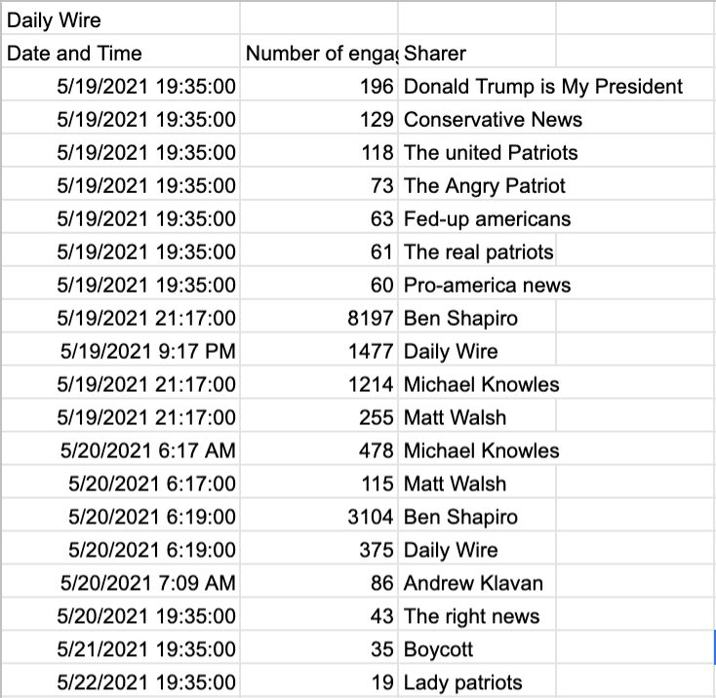
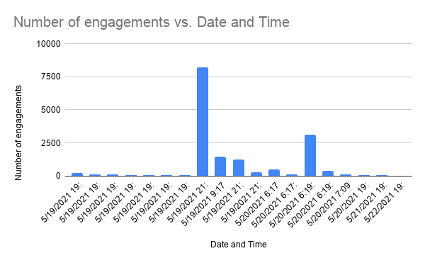
Example Article Analysis with CrowdTangle
Daily Wire article about Rashida Tlaib conversing with President Biden regarding the Israel-Palestine conflict

Slide 6
Insights and Takeaways
Severe misinformation problem regarding right-wing pages still exists.
Facebook has taken actions to improve content moderation practices, such as:
  Fact checker network of 80 sources
  COVID-19 Information Center, US2020 Voting Information Center, Climate Science Information Center
  Oversight Board
Facebook does not have any real measures of accountability / policy enforcement
  Systematic promotion of Daily Wire content by duplicate/bogus accounts was reported and continues to operate and spread posts to millions of users
Additional data needs to be released surrounding post reach and content promotion policies
Notes:
Overall, further action needs to be taken on the part of regulatory bodies and Facebook itself to increase Facebook’s accountability and

Slide 7
Thank you:
Prof. Ninez Ponce
Prof. Peter Reiher
Prof. Leonard Kleinrock

