Slide 1
Transfer Learning and Hybridization for adventitious lung sound detection
Internet Research Initiative 2020-2021
Suraj Vathsa

Slide 2
Goal
Ideas
Detect adventitious lung sounds as a first step in autonomous respiratory disease diagnosis.
Employ transfer learning, i.e., using an existing deep learning model trained for a similar task.
Employ hybridization of two types of deep learning models to incorporate spectral and temporal features that can be generated from lung sounds.
Data imputation using generative modelling to augment training data
Develop an Artificial Intelligence (Deep Learning)
enabled system to identify adventitious sounds such
as wheezes and crackles in audio recordings of
patient lung sounds.
Research Method/Process
ICBHI 2017 Dataset provides a total of 5.5 hours of recordings containing 6898 respiratory cycles.
Previous works train simple CNN or simple RNN from scratch.
Trained VGGish, a popular audio classification model hybridized with a recurrent neural network for the task of detecting crackles and wheezes.
Lack of quality data was a major challenge. Addressed using audio manipulation tricks and generative modelling.
Convolutional Variational Autoencoder employed for generative modelling.
Findings/Conclusions/Next Steps
Hybridization was useful in both the tasks of crackle and wheeze detection while transfer learning helped in boosting the performance in crackle detection.
Downstream diagnosis was still unsatisfactory since various key features such as patient medical history and geography were missing from the dataset.
Future work includes building a comprehensive dataset which incorporates lung sounds, patient history, patient demographics, and environmental variables of patient’s location. Further developing generative modelling to help with effective data imputation.

Slide 3
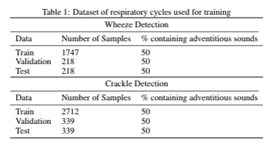
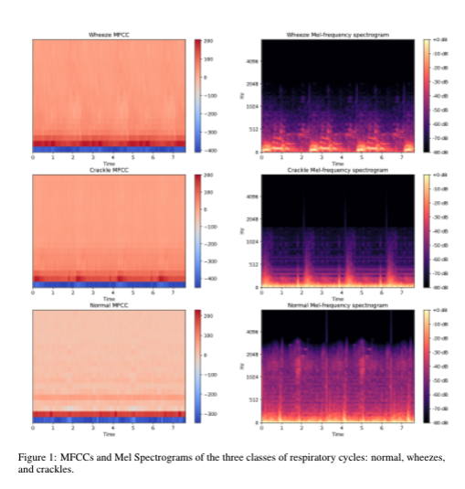

Dataset
ICBHI 2017 Challenge
Preprocessing
  Respiratory cycle centric
  Repetition of respiratory cycles
  Audio augmentation
  Features extraction from raw audio (mel spectrograms and MFCCs)
Audio Generation
Generated Wheeze
Natural Wheeze

Slide 4
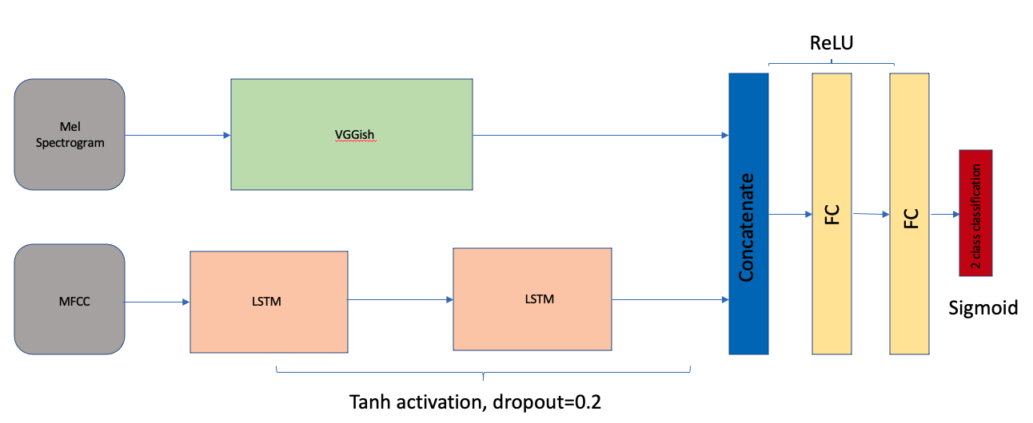
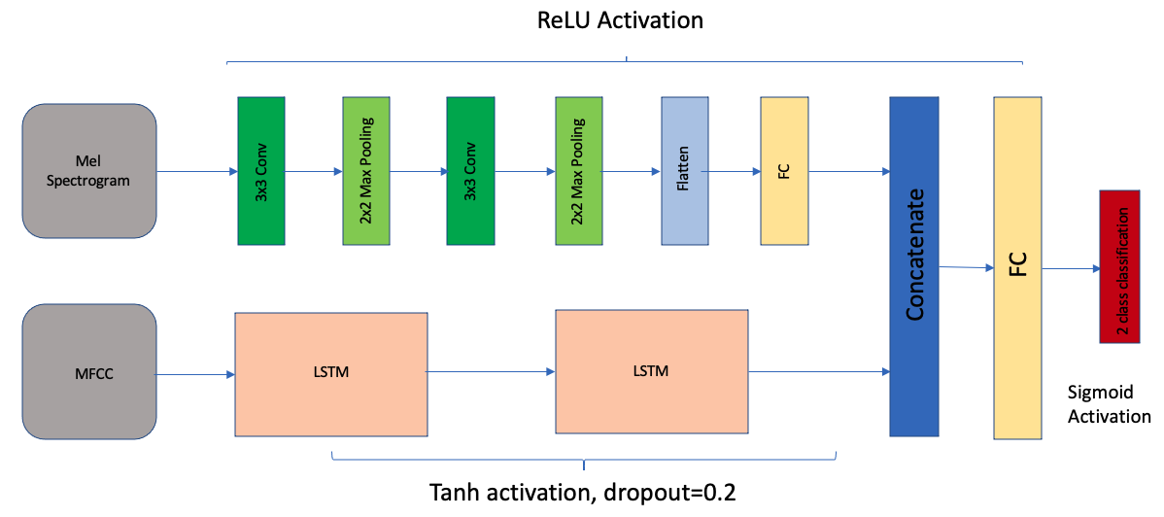
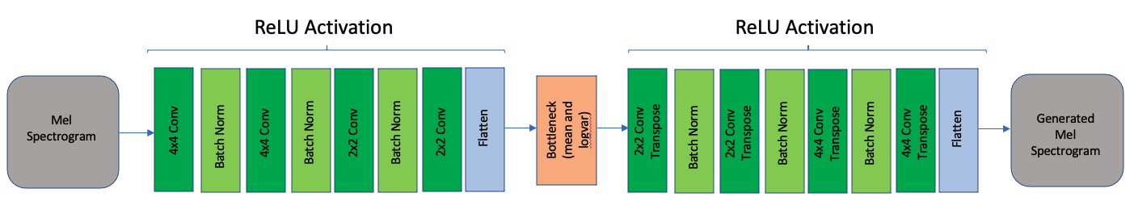
Deep Learning Models Used
VGGish + LSTM
CNN + LSTM
Convolutional VAE

Slide 5
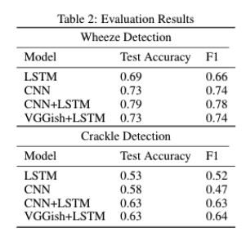
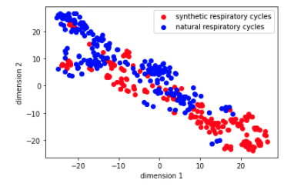
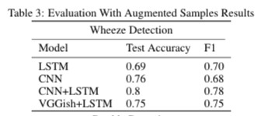
Results
Hybridization (CNN + LSTM and VGGish + LSTM) outperforms simple deep learning models
Transfer Learning helps in crackle detection.
TSNE plot

Slide 6
