Slide 1
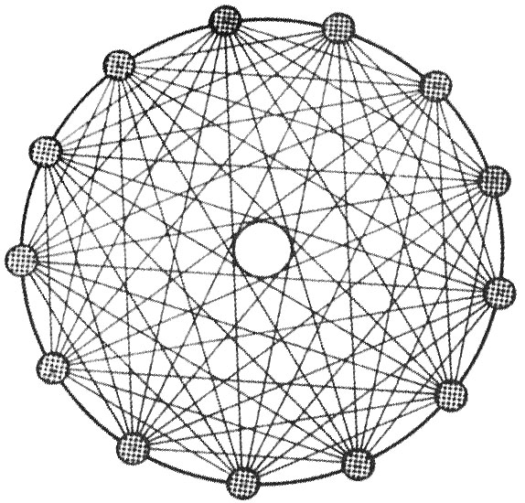
IRI:
Tweets in State-level
Public
Diplomacy
Liam Monninger

Slide 2
Tweets in State-level Public Diplomacy
Topic:
Ideas:
Tweets in state-level public diplomacy
Is the tweet an effective instrument of public diplomacy?
What might this mean for international politics? medium theory? ect.
Many established models: the response a tweet garners from a foreign regime ought to be related to its audience
Do I find evidence to support these models?
Research -- Methods and Challenges:
Findings:
Core statistical approach
Difficult to find appropriate variables; lack of precedent
Low n
Not so much definitive as provocative
Little to no relationship between tweet audience and tweet response in my data
Challenges commitment device, agenda setting and norm promoting models
Media determinism as whole dubious in light of my research

Slide 3
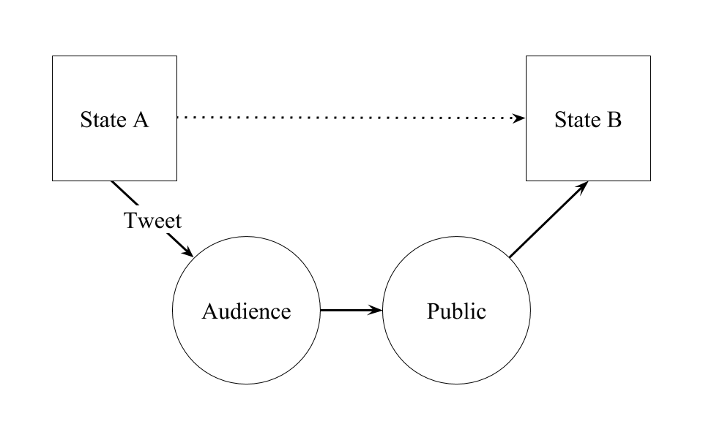

Slide 4
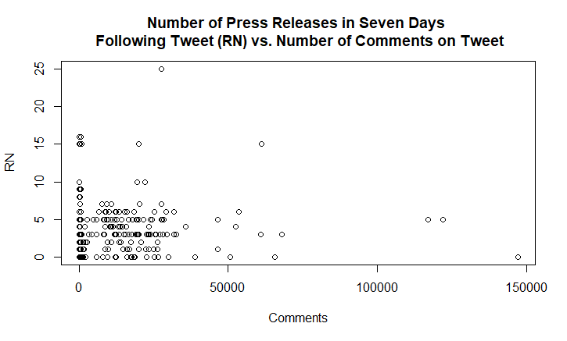

Slide 5
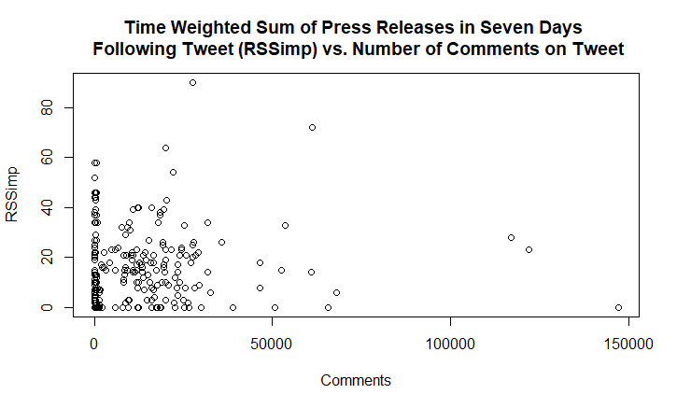

Slide 6
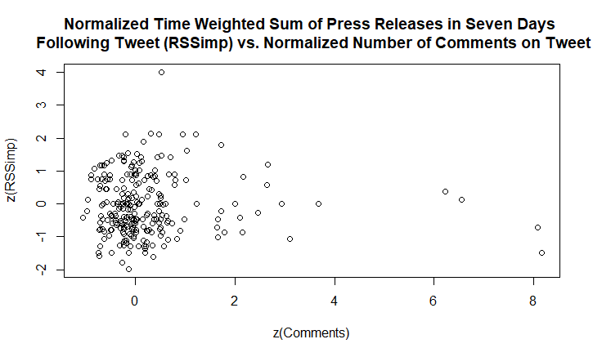

Slide 7
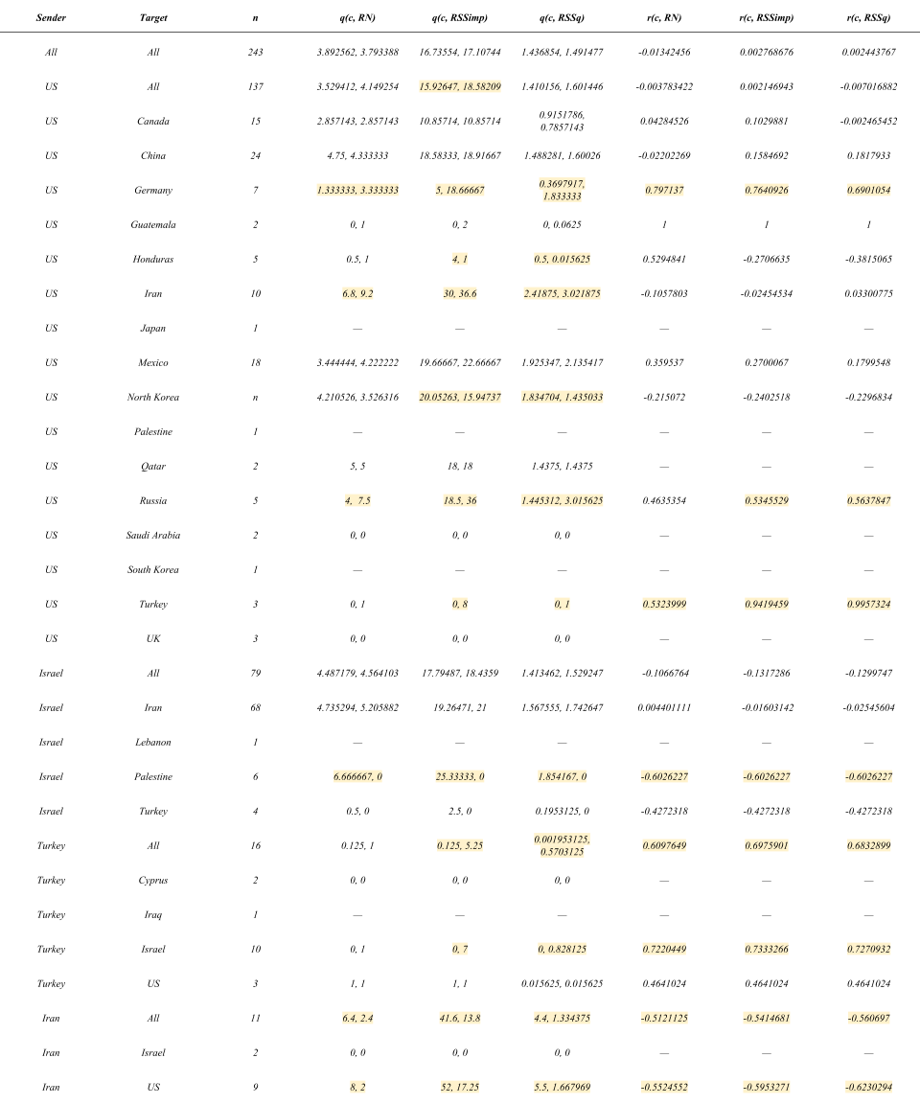

Slide 9
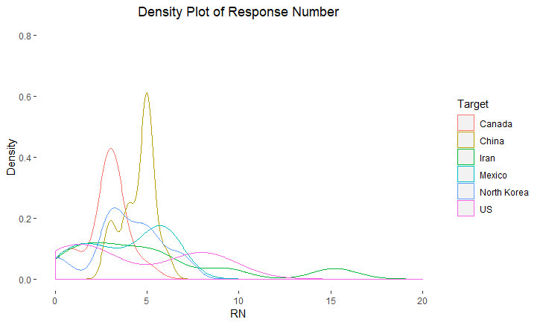

Slide 10
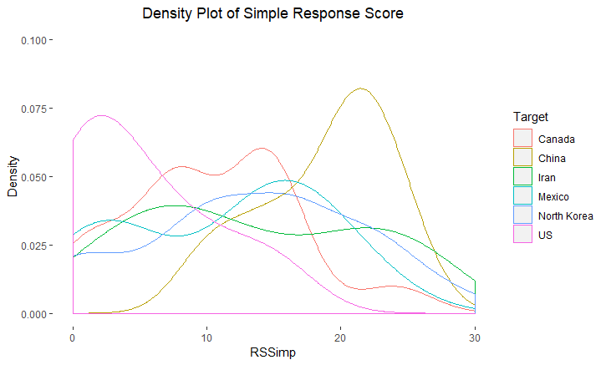

Slide 13
?

Slide 14
Perspectives:
I. Commitment Device
II. Agenda Setting
III. Norm Promotion

Slide 15
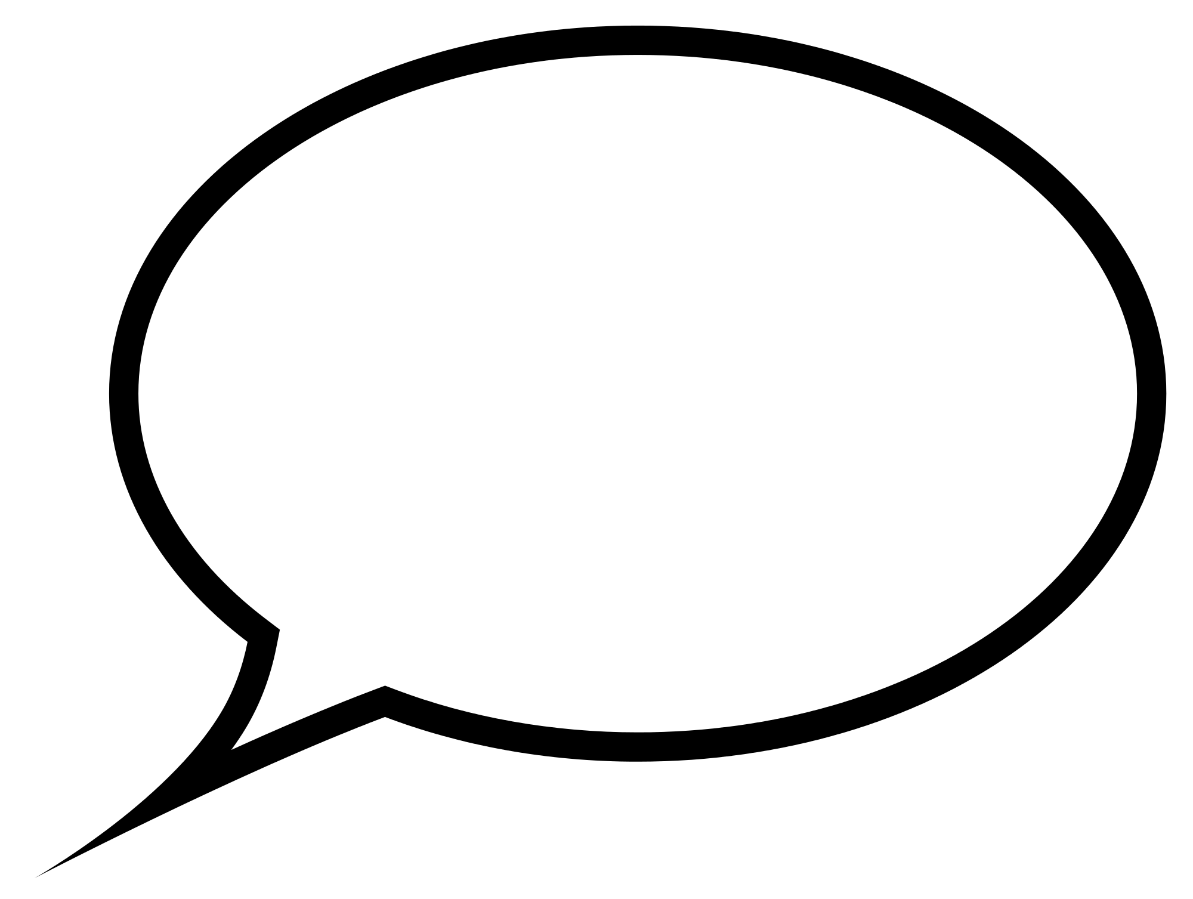
Commitment Device

Slide 16
Commitment Device
Tweets are not costly enough.

Slide 17
Agenda Setting

Slide 18
Agenda Setting
Tweets set the agenda of the other state more or less directly, if at all.

Slide 19
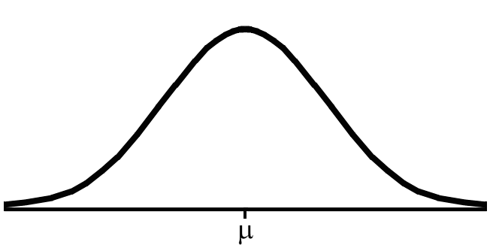
Norm Promotion

Slide 20
Norm Promotion
Tweets are likely weak norm promoters as they seem to fail to establish norms around their own use

