Slide 1
Introducing... the Internet
Methods and design for an Internet literacy curriculum which adapts online participatory culture into the secondary-education classroom by coordinating factual instruction with informal learning formats.
by Nephele Troullinos, mentor: Miriam Posner

Slide 2
“The Internet and Us” is a theoretical curriculum that aims to provide young students with a comprehensive understanding of the Internet within their secondary education. Informed by the principles of critical media literacy, this research-based course reconsiders the Internet thematically and guides students using alternative instructional formats to deepen engagement and learning about the Internet.
“the Internet” in
6 themes
Research Area
TeachingContent
LearningMethod
Syllabus [didactic component]
x
Participatory Classroom
teaching the
Brain & Behavioral Science of digital media use
New Ideas
CML Review
Literature Review
GSEIS Course Syllabi & Library Research Guides
Applied Neuroscience PSYCH 79
UCLA Lab School Pedagogy
newsletters, documentary films & series
outcome
research-based curriculum with syllabus and instructional guide
limitations
hypothetical, few parameters
moving forward
refine with feedback from peers & mentors, adapt to real-time context: apply to research at UCLA Lab School
Methodology / Process
notes…. collect resources…. more notes….
the Challenge: How to synthesize / simplify ?
Conclusion / Next Steps
How to engage middle-schoolers to reflect on the Internet and digital media in educational setting?

Slide 3
Syllabus
“The Internet and Us”
informational content broken down into 6 themes
instructor aims to guide students through each module
moderates classroom activities, discussions, reflections
History
How It Works
the WWW
a survey/timeline up until today & speculation of future developments
physical & digital
infrastructure / operations
breadth of browser features
and content
Media Literacy Praxis
Virtual Sociality
Brain-Behavioral Science
concepts and educational principles to
build skills and agency
Social media platforms, computer-mediated connection and community
of internet & digital media use, human-
computer-interaction

Slide 4
cognitively guided instruction
direct modeling
formal vs. informal
“The Internet and Us”
Participatory Classroom
inquiry
collaboration
simulations
performance
discussions
affinity space
participatory cultures

Slide 5
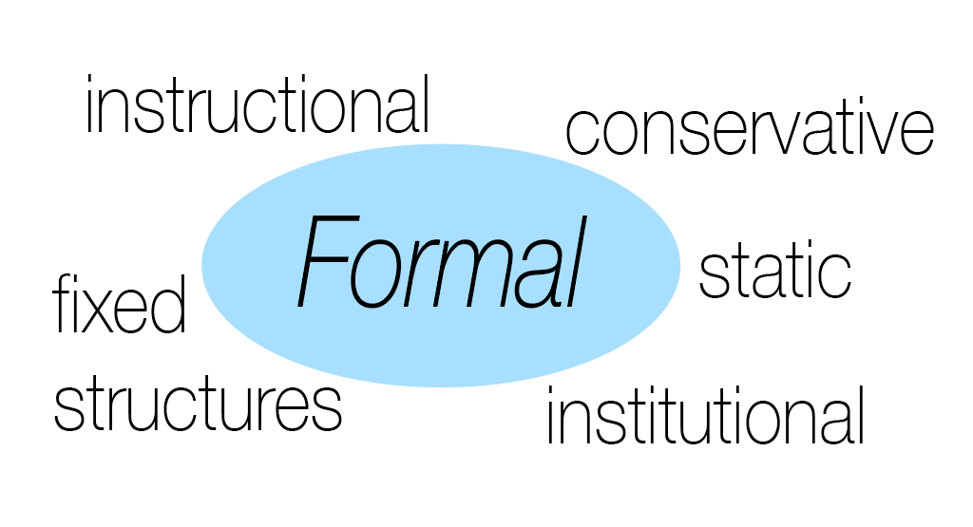
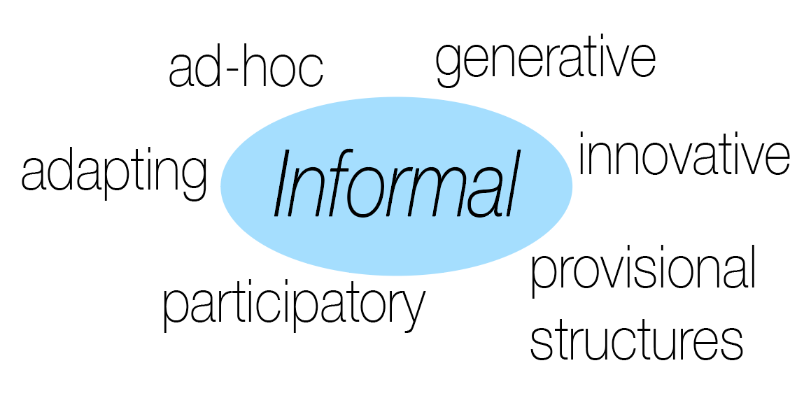

Slide 6
future directions : UCLA CONNECT Lab School Research
Goals: complete comprehensive teacher training guide for curriculum
Benefits of Research: an informed and trained teacher is able to facilitate personally motivated assessment of the internet, contributing to digital/online agency and deeper learning at an early age, aiming to improve safety, everyday use, and well-being online
Subject Selection Criteria: 10-15 students of same age group, Upper I & II - ages 10 to 14 (middle school students), students remain with same group for at least 10 class sessions
Methods / Instruments: intervention/new curricula, survey, observation, interviews (individual), interviews (group), simulations & activities using video, audio, writing, arts media

