Slide 1
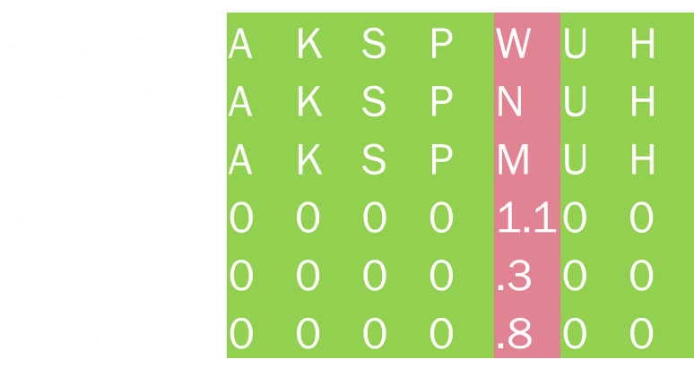
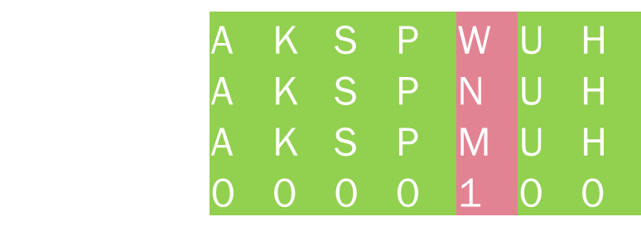
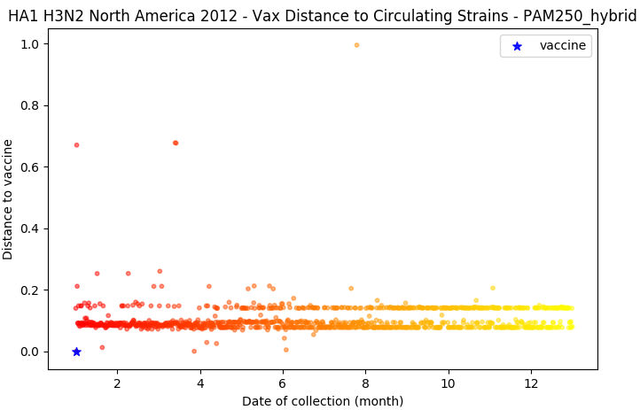
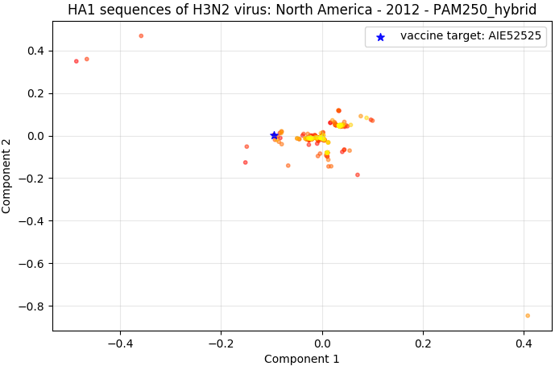
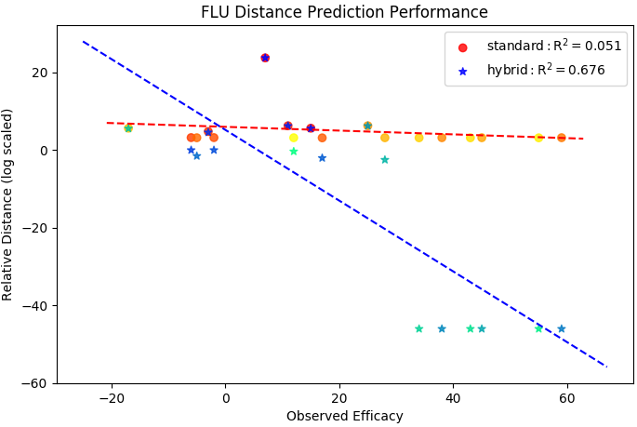
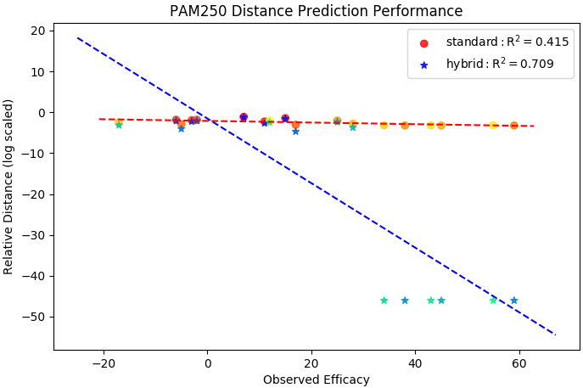
Computational flu vaccine analysis The long timeline of seasonal flu vaccine selection and production limits vaccine efficacy. A computational analysis based on protein structure could allow vaccines to be optimized against circulating strains instead of previous strains. | Question: How do we best predict flu vaccine efficacy by looking at sequences? → Look at “distances” between vaccines and circulating strains
Wet-lab experiments with vax candidates
WHO selects vax
Vax synthesized
Vax released
Feb
Mar
Apr
May
June
July
Aug
Sept
Oct
ID best vax w/ comp. analysis
WHO selects vax
Vax synthesized
Vax released
Previous work in this field weigh all substitutions evenly (Hamming distance).
Drawing from structural biology, I plan to weigh substitutions based on their contribution to 3D structure.
Used substitution matrix to weigh each point mutation.
Analyzed performance of each method on historical data set.
Created two new “hybrid” distance methods that only used matrices for mismatches.
Maps of distance to vaccine (left) and 2D representation of all strains (right) using the PAM250 hybrid distance method.
Can see how well the 2012 vaccine covered circulating flu strains.
Future directions:
Validate PAM250 hybrid with in vitro/vivo experiments.
Weigh positions differently or switch to ensemble free energy.
Notes:
DOI: 10.1042/BJ20121221

